Slide 1
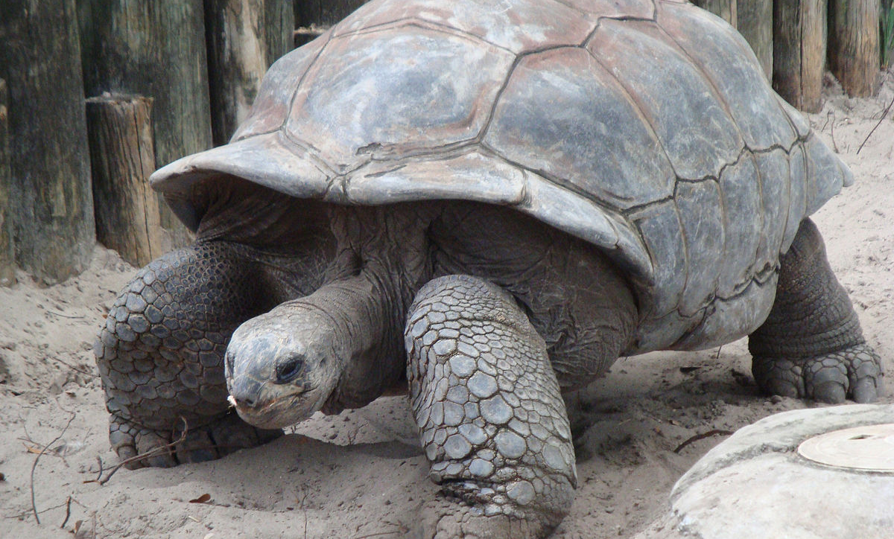
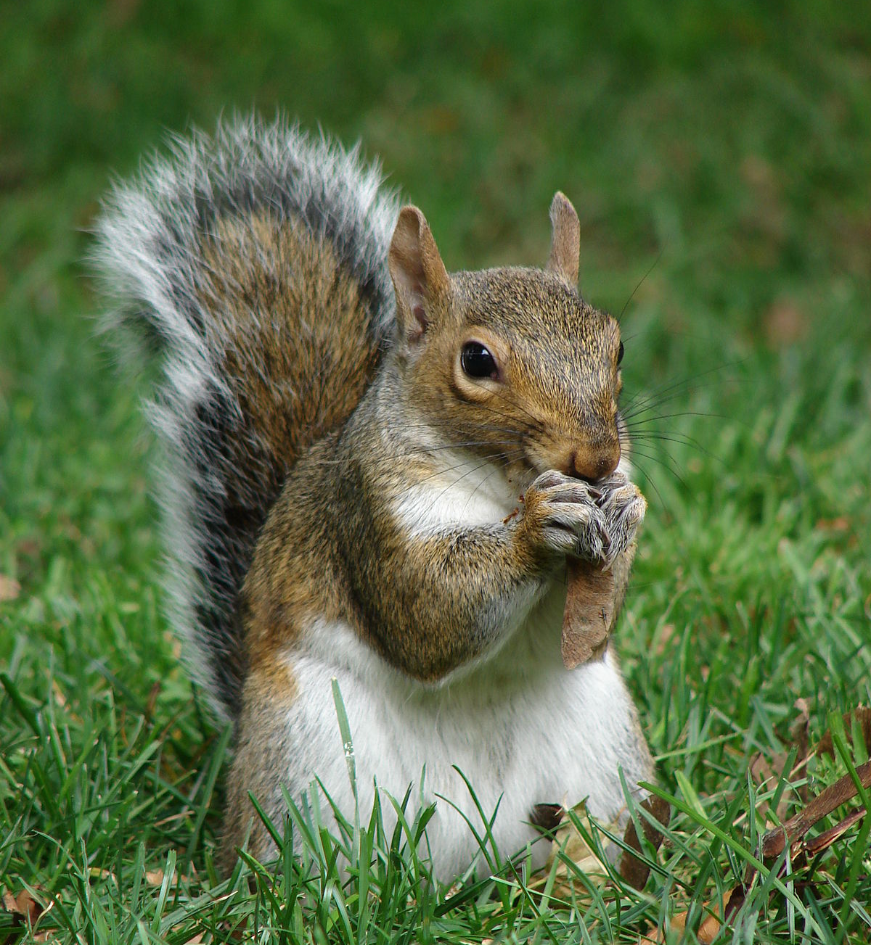
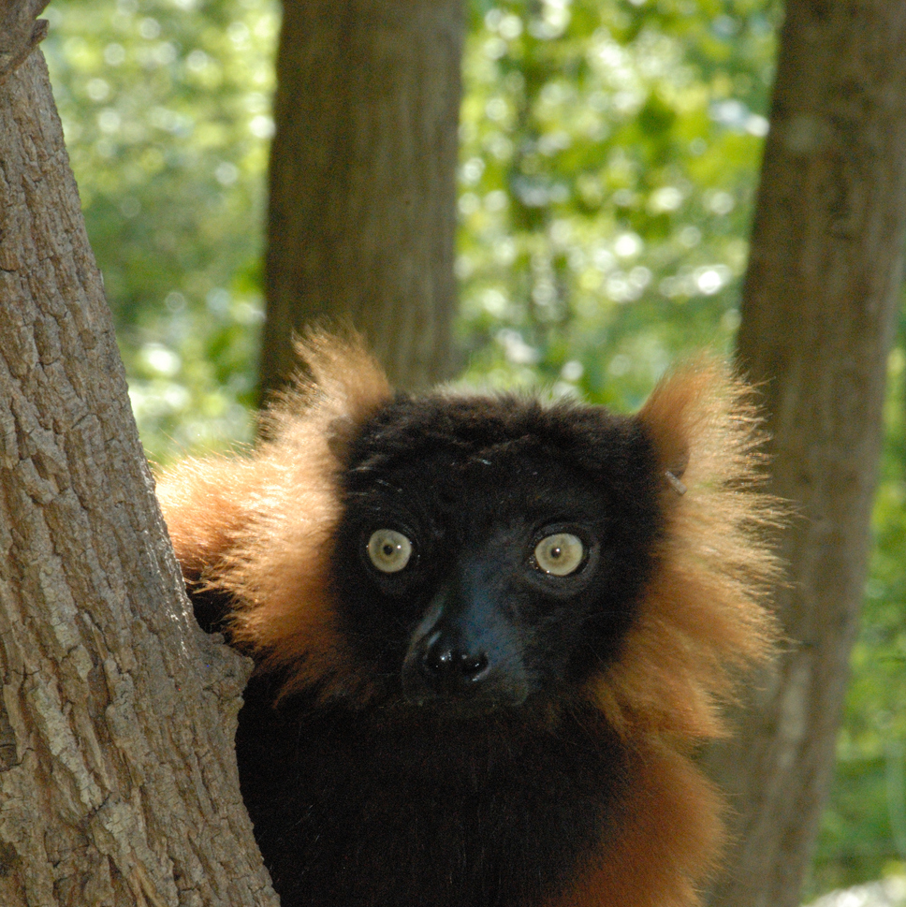
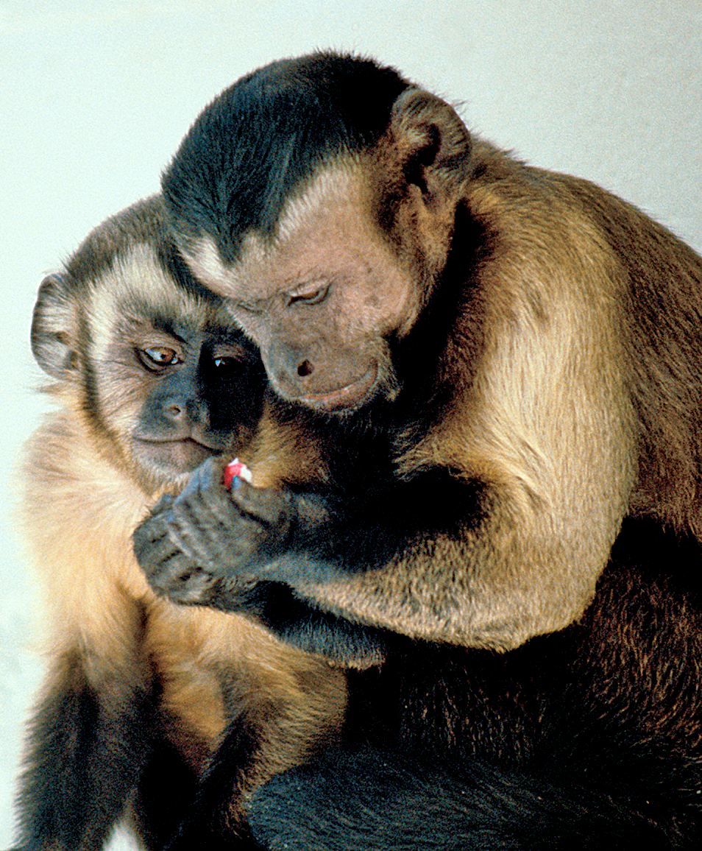
As you arrive brainstorm:
If being a chair/director is an animal, what animal is it and why?
Notes:
As people come in, welcome them and point them to the prompt. Make list of attendees’ names to be posted into Chat during introductions to indicate the order we will follow.

Slide 2
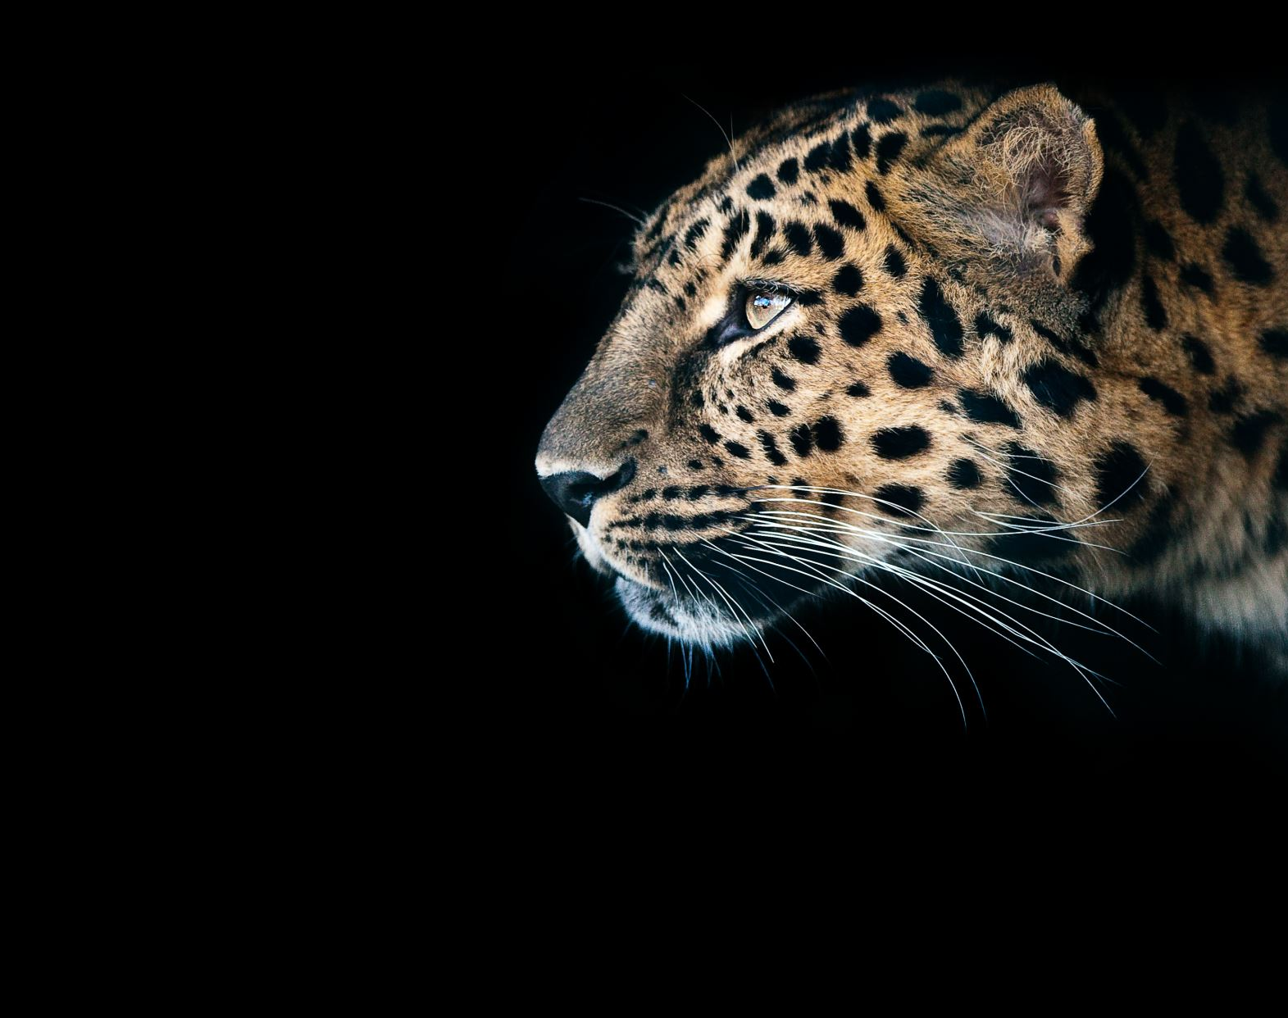
A Walk on the Wild Side
New Chair/Director Orientation
August 27th, 2020
Notes:
Welcome: My name is Erin Willer. Keith Ward, Rashida Banerjee, Sandra Eaton and I are members of Chair Development group

Slide 3
Introductions
Name
Department/Unit
“Being a chair/director is like a [name of animal] because ______________.”
Notes:
Please keep very brief
Keith, Rashida, and Sandra go first

Slide 4
Today’s Agenda
No Need for a Wild Goose Chase: Introduction to the Chair Handbook
Putting the Fish Back in the Water: Key Issue Breakout Group Discussions
Birds of A Feather Come Back Together: Q&A

Slide 5
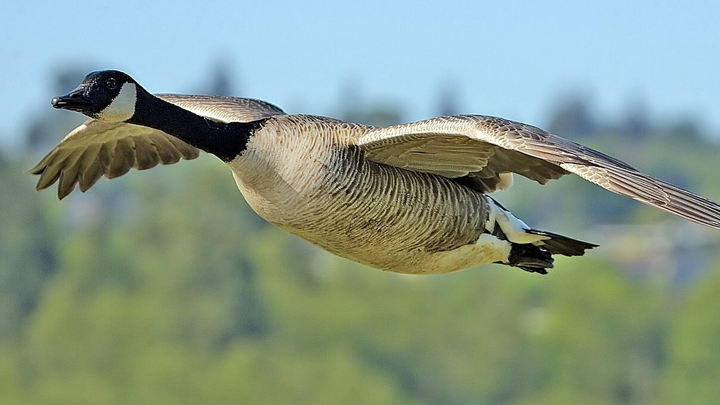
No Need for a Wild Goose Chase: Introduction to the Chair Handbook
https://duvpfa.du.edu/chair-handbook/
Notes:
Copy and paste website into chat

Slide 6
Putting the Fish Back in the Water: Key Issue Breakout Group Discussions
Keith’s Kangaroos
Chair Well-being
Rashida’s Raccoons Leading Faculty Meetings
Sandra’s Salamanders Supporting Faculty
Notes:
Please type into Chat the name of the animal associated with the breakout group you would like to be a part of.

Slide 7
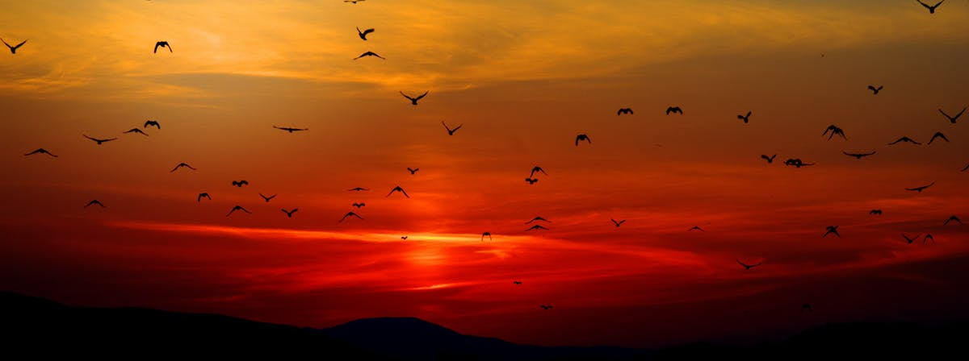
Birds of A Feather Come Back Together
What were key themes/take aways from your breakout groups?
What questions and concerns do you have as you prepare for the new year?
Notes:
Take a screen shot

Slide 8
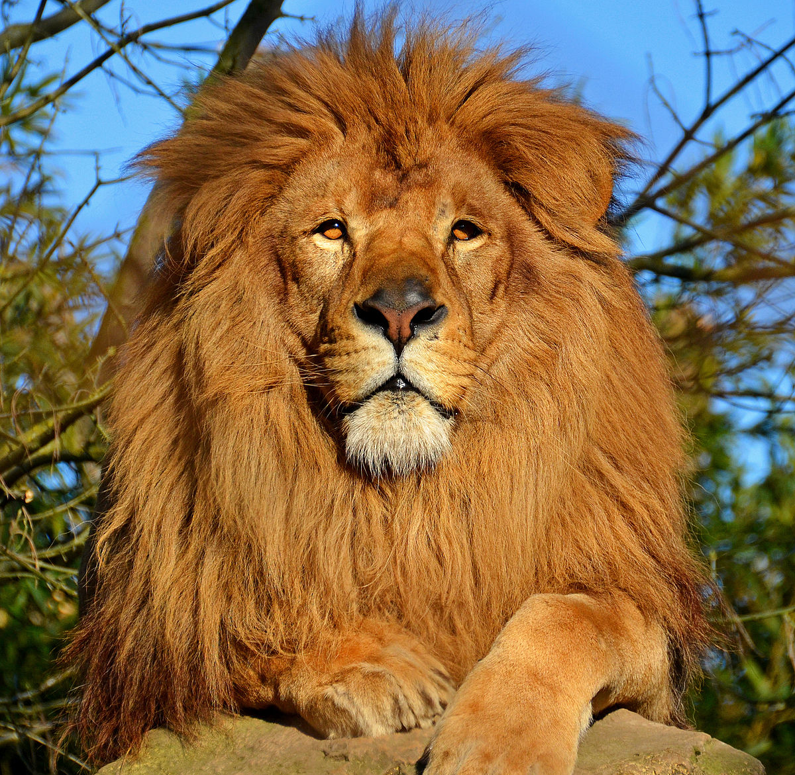
Lion’s Share Closing
Share the name of a “power animal” you would like to call on as you start the new school year.
Notes:
A power animal is one that you want to imagine yourself to be, one you can call on for strength, or one that can empower others for example.
For the sake of time, please just say the animal’s name.

